Slide 1
Nilura Clothing-ECommerce

Slide 2
Table of contents
01
02
03
Introduction
System Analysis
Project Scope and Requirements
04
05
06
Development Process
System Design
Implemntation Challenges and Future Work

Slide 3
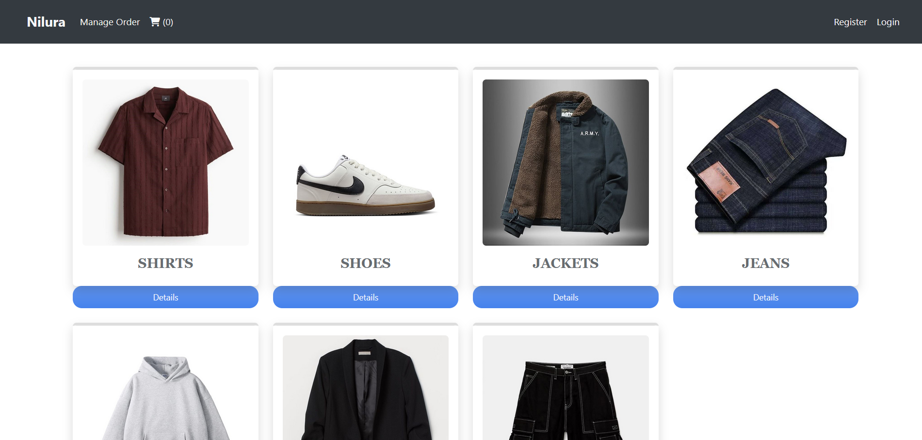

Slide 4
01
Introduction

Slide 5
Overview of the project The project is an e-commerce platform tailored for clothing sales, enabling customers to browse, purchase, and track clothing items, while administrators manage product catalogs and customer orders.
Problem statement There is a growing demand for efficient and user-friendly online platforms in the clothing industry, making it easier for users to purchase and receive products seamlessly.
Objectives and goals To build a responsive, secure, and scalable platform with features such as user management, product browsing, shopping cart, payment integration, and order tracking

Slide 6
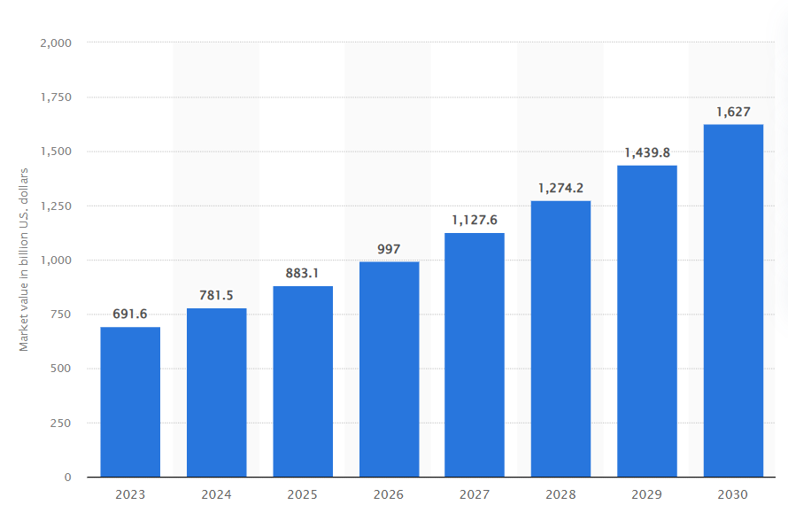
Fashion e-commerce market value worldwide from 2023 to 2030

Slide 7
Target
Gender
Age
30%
50%
20%
90%
10%
18 - 20
21 - 35
+36

Slide 8

02
System Analysis and Requirements

Slide 9
Functional Requirements
User Management
Account creation, login via email or social media.
Two-factor authentication, password recovery.
Wishlist functionality for favorite products.
Product reviews with ratings (1-5) and comments.
Product Management
Display products with details and images.
Organize products into categories and subcategories.
Inventory management for tracking stock.
Discounts, coupons, and promotional campaigns.

Slide 10
Functional Requirements
Shopping Cart
Add, view, update, and remove items from the cart.
Save cart for future sessions and guest checkout.
Complete checkout with shipping and payment details.
Order Management
Track order history, cancellation, and returns.
Multiple shipping options and tracking.
Email notifications for order status updates.

Slide 11
Functional Requirements
Payment Integration
Multiple payment gateways (PayPal, Stripe).
Support for cards, bank transfers, and digital wallets.
Secure payment processing and transaction history.
Admin Dashboard
Manage products, categories, and inventory.
View orders, user accounts, and reports.
Role-based access control for staff.

Slide 12
Non-Functional Requirements
Performance.
Security.
User Experience.
Maintenance.

Slide 13
04
Development Process

Slide 14
Development Process
Methodology : Waterfall development methodology
Milestones • Phase 1: Requirements Gathering • Phase 2: Database Design • Phase 3: Development • Phase 4: Integration • Phase 5: Testing • Phase 6: Deployment.
Tools used in development : Visual Studio, SQL Server and GitHub.

Slide 15
05
System Design and Architecture

Slide 16
System Design Overview
Three-Tier Architecture:
Presentation Layer: ASP.NET Core MVC with Razor Pages for UI.
Business Logic Layer: Manages product listings, orders, users and payments.
Data Access Layer: Entity Framework Core for database operations (SQL Server).
API Integrations:
Payment Gateways: PayPal, Stripe for secure payment processing.
Shipping API: Real-time shipping status updates.
Social Login: OAuth (Google, Facebook) for user registration.

Slide 17
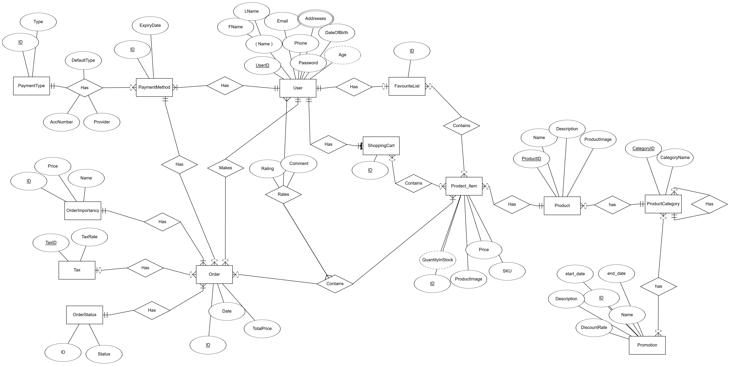
Database Design

Slide 18
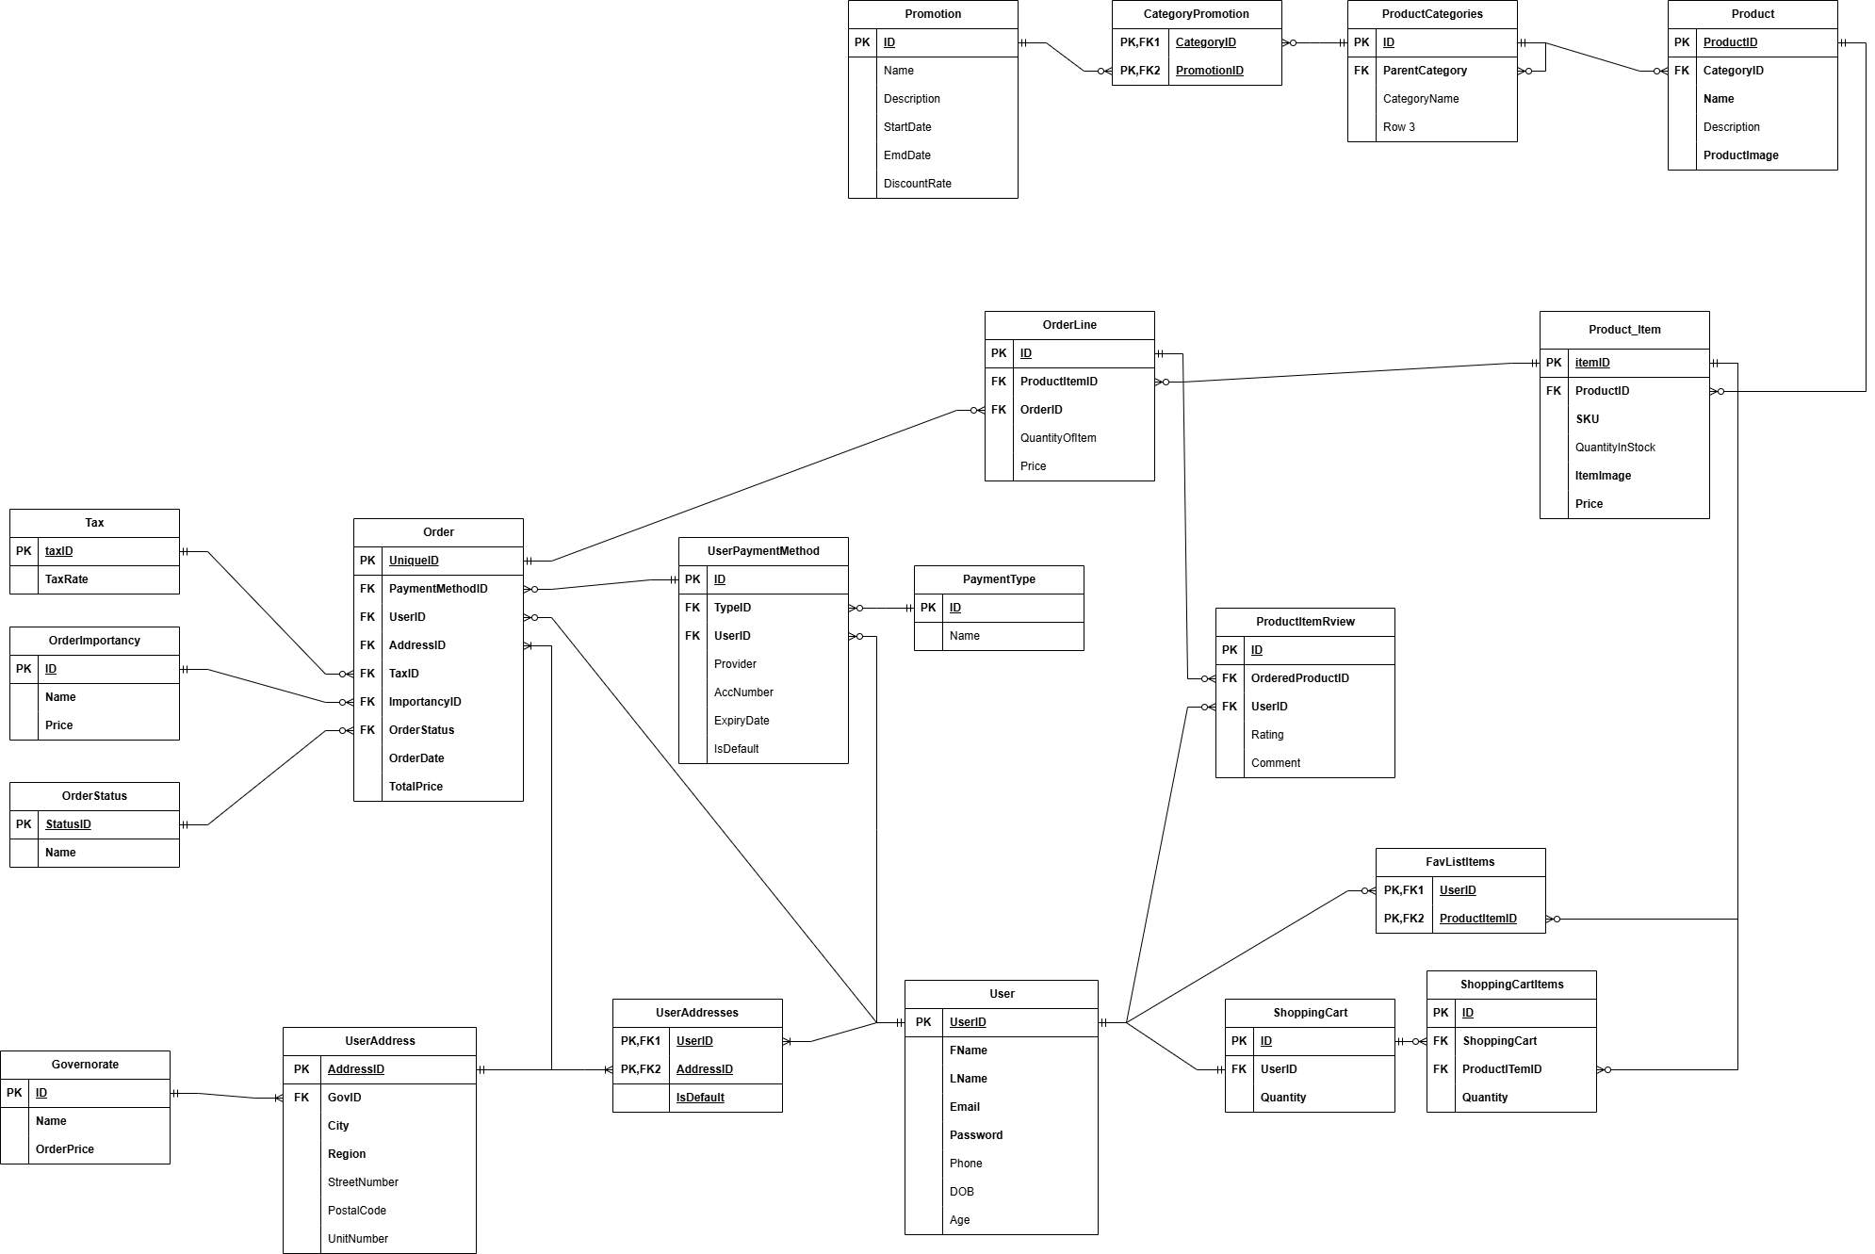
Database Design

Slide 19
Security & Authentication Overview
Authentication
ASP.NET Identity for user login and roles.
OAuth for social logins (Google, Facebook).
Authorization
Role-based access control (RBAC) for admin and customer roles.
Data Protection
SSL encryption for secure communication.
AES encryption for sensitive data like passwords.

Slide 20
Performance & Scalability
Performance Optimization
Caching : Frequently accessed data (products, categories) to speed up load times.
Lazy Loading : Defer loading of associated data (e.g., product reviews) for better performance.
Scalability
Cloud-based hosting (Azure, AWS) for horizontal scaling..
Auto-scaling: To handle traffic spikes during promotions or high-demand periods

Slide 21
06
Implementation

Slide 22
Implementation
Technologies Used
Front-End : HTML, CSS, JS, Bootstrap
Back-End : C#, APS.NET Core 8, MVC pattern, SQL Server.
Design Patterns : Dependency Injection, Repository, UnitOfWork, Specification.
Identity Package for Authentication and Authorization.
Architecture : N-Tier Architecture.

Slide 23
Development steps
Define Models
Set Up the Database Context
Create Configurations For Our Models
Create Repository Interfaces
Define generic repository interfaces (e.g., IRepository<T>).
Include common methods like Add, Update, Delete, and GetAll.
Create specific repository interfaces for your entities (e.g., IProductRepository).
Implement Repository Classes
Create classes that implement the repository interfaces (e.g., ProductRepository).
Inject DbContext into the repository constructor to handle data operations.

Slide 24
Development steps
Set up the UnitOfWork Pattern
Create a IUnitOfWork interface that defines a method for saving changes.
Implement the UnitOfWork class, which manages the repositories and DbContext.
Configure Dependency Injection
Create Controllers and Views
Implement Validations and Error Handling
Testing
Deployment

Slide 25
Challenges
Waterfall development methodology.
Database Schema Changes
Maintaining Separation of Concerns
Testing with Dependencies
API Integrations (Payment Gateway, Social logins)
Handling Asynchronous Operations

Slide 26
Future Work
User products favorite list.
Category promotions.
Product item review.
Order features (tax, status, …).
Multiple payment types.
Multiple user addresses.
Inventory management to track stock levels.
Email notifications for order updates.
AI based recommendations.

Slide 27
Group Code : NEXT27 _DKH1_SWD5_S3d Team members :
Mohamed Ramadan Mansour.
Hisham Abdallah Kamal Abdelhamed.
Omar Mohamed Reda Mohamed.
Ahmed Ahmed Mohamed Bashar.
Khaled Mohamed Abdelaziz Elshrbeny.
Ahmed Nabil Mohamed Elzayda.
Mohamed Zaghloul Rashad Alorabi.

Slide 28
Thanks ☺

